Slide 1
WISDM v5.1 Dataset
Group Members: Joao Lucas Veras and Sania Bandekar
Team Number: 6

Slide 2
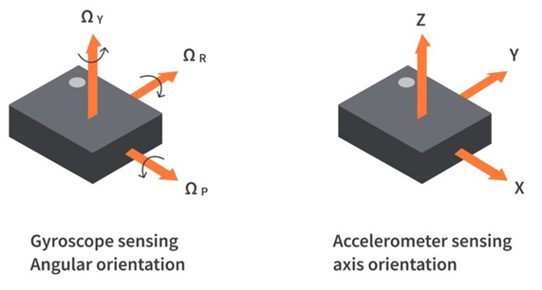
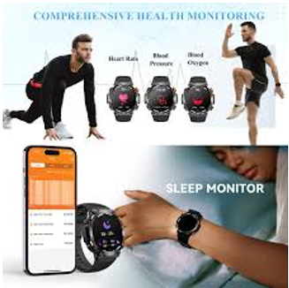
Wireless Sensor Data Mining (WISDM) v5.1 Description
Data is used for building and evaluating biometric models and human activity recognition models
Dataset that was collected by 51 subjects who performed 18 diverse activities of daily living
Data was collected by an accelerometer and gyroscope of a smartphone and smartwatch

Slide 3
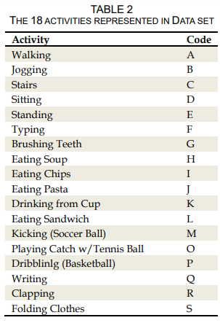
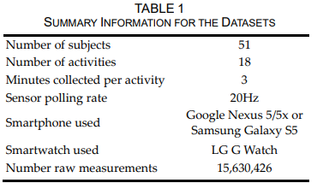
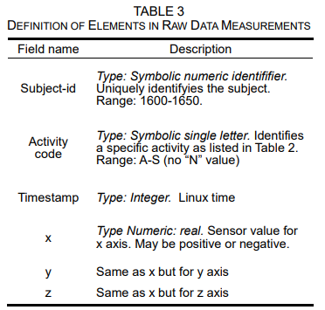
Details and Specifications

